Slide 1
Clinical Case Logs:
How to Streamline Required Documentation
Diana Amundson, MBA, CST, CSFA

Slide 2
Program Overview:
Bellin College
Green Bay, WI
Bachelor’s Degree in Surgical Assisting
Primarily In-Person Program
CAAHEP Accredited SA
In Process: Initial Accreditation ST

Slide 3
Clinical Case Logs
Digital Option vs. Paper Option
What is the most efficient way for students?
How can we minimize the work placed on Clinical Coordinators?
Previous Process for Bellin College:

Slide 4
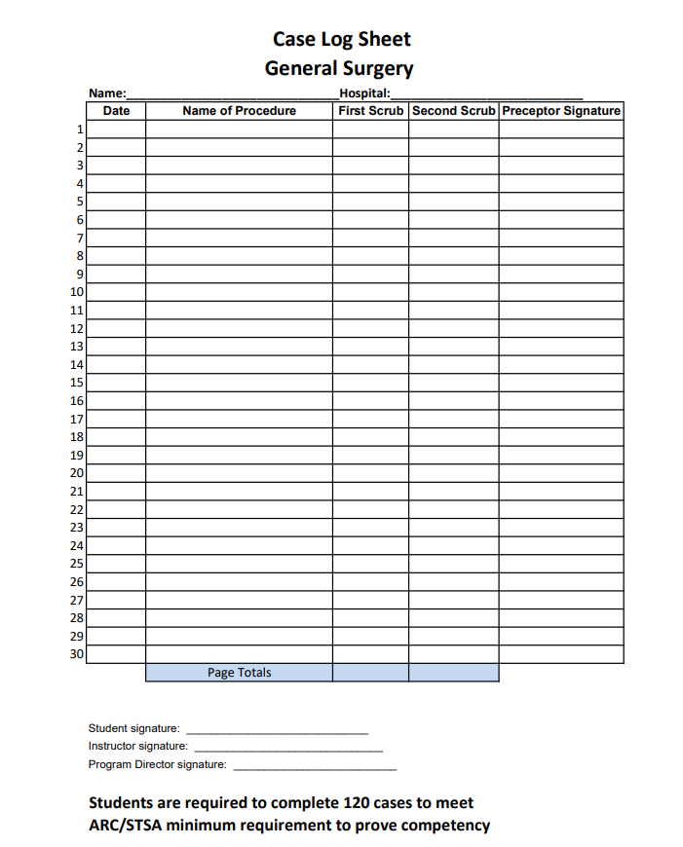
Initial Examples:

Slide 5
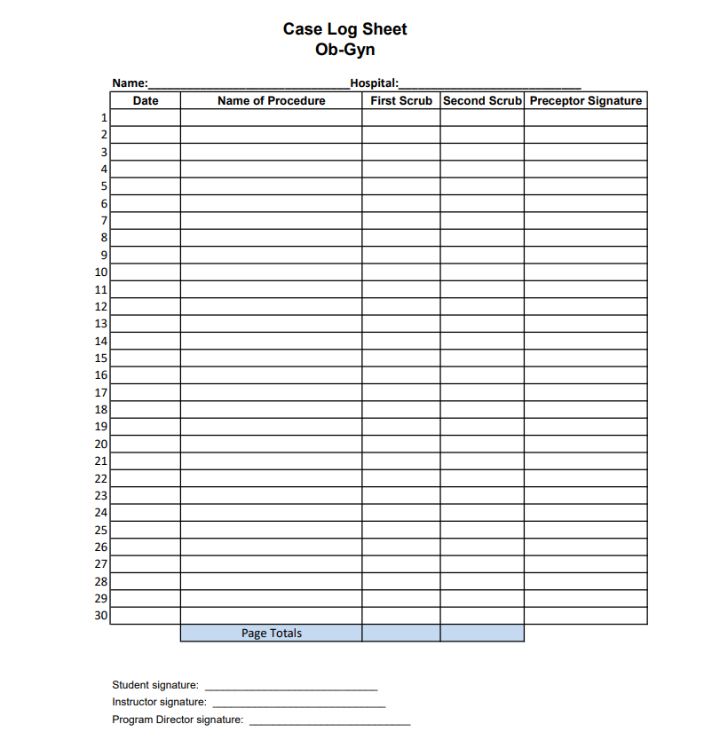
Initial Examples:

Slide 6
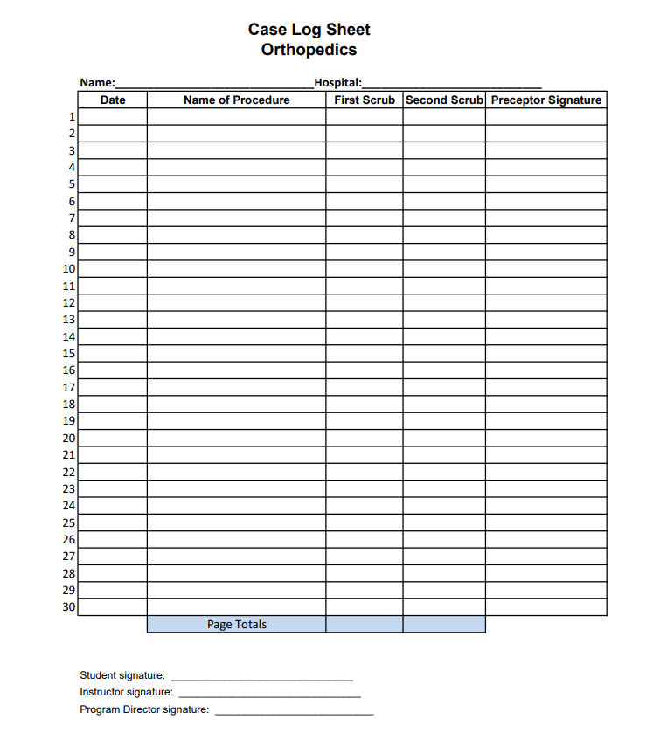
Initial Examples:

Slide 7
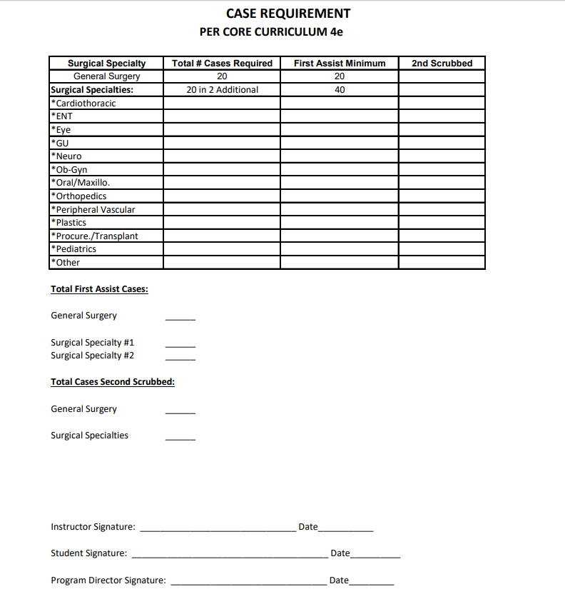
Summative Case Logs: Previous Process

Slide 8
Current BSSA Process:
Individualized Google Form for Each Student
Automatically Loads Responses in Excel Spreadsheet
Easy to Keep Track of Case Type and Specialty
Time Efficient for Student and Instructor

Slide 9
Google Forms:
Create Initial Form
Easy to Change and Make Corrections
Timestamp of Student Responses
Can Be Seamlessly Linked to a Response Format of the Program’s Choosing

Slide 10
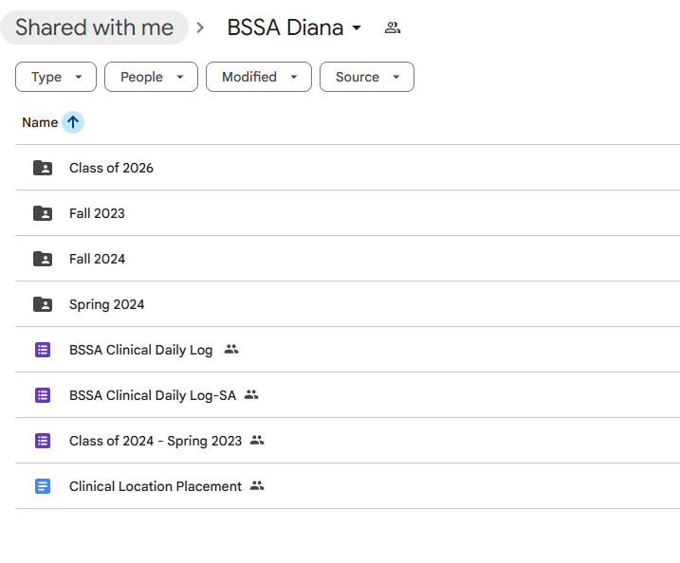
Creating an Individualized Google Response Form:

Slide 11
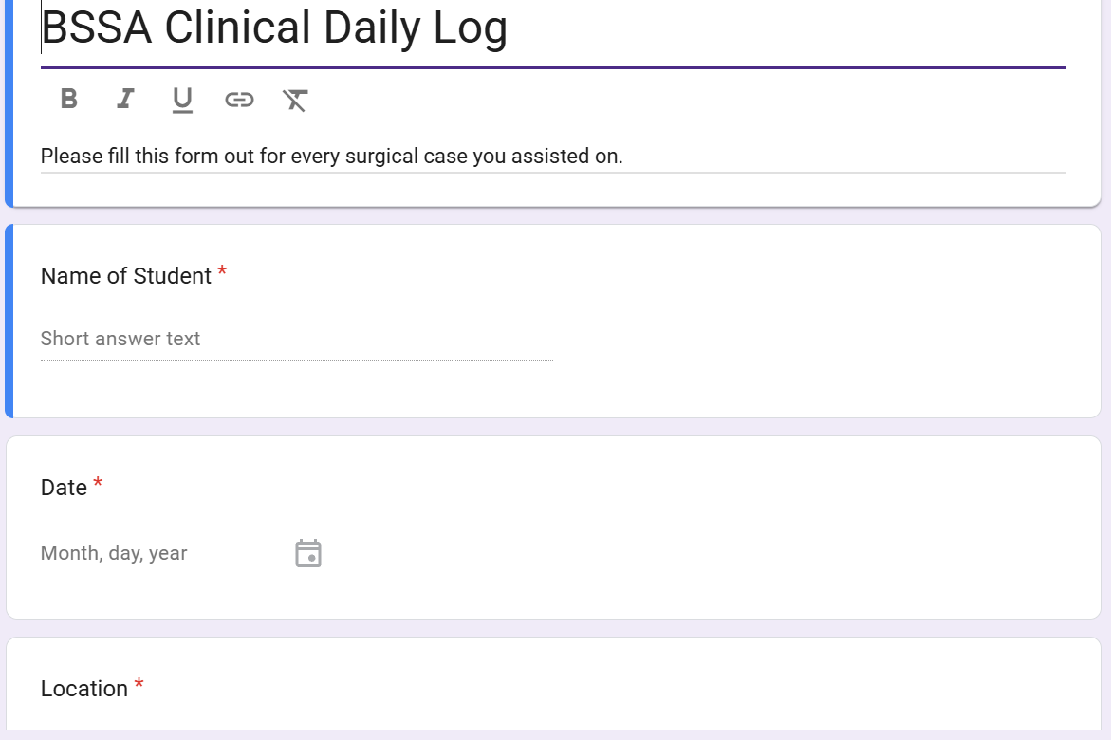
Creating an Individualized Google Form:

Slide 12
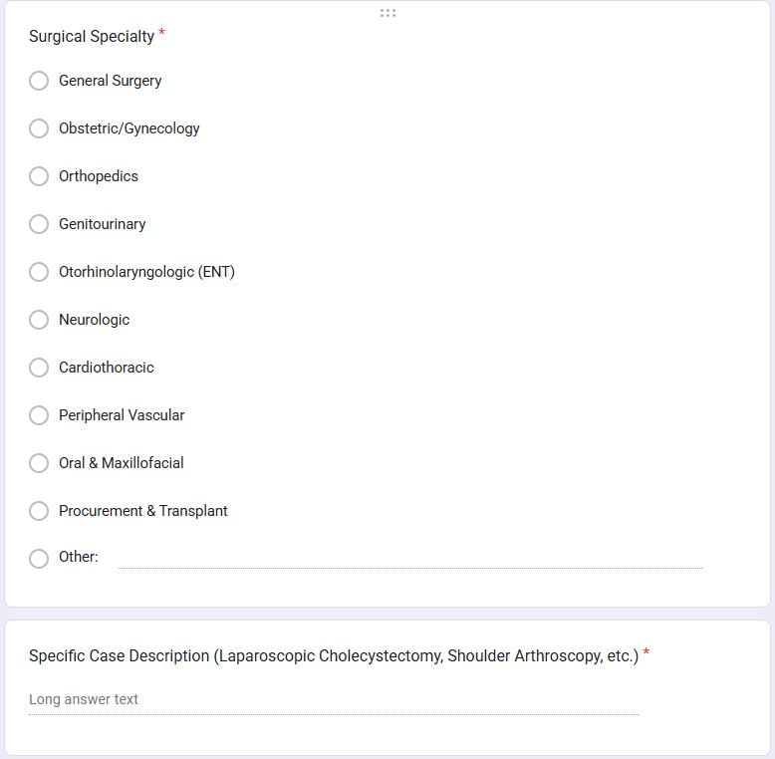
Creating an Individualized Google Form:

Slide 13
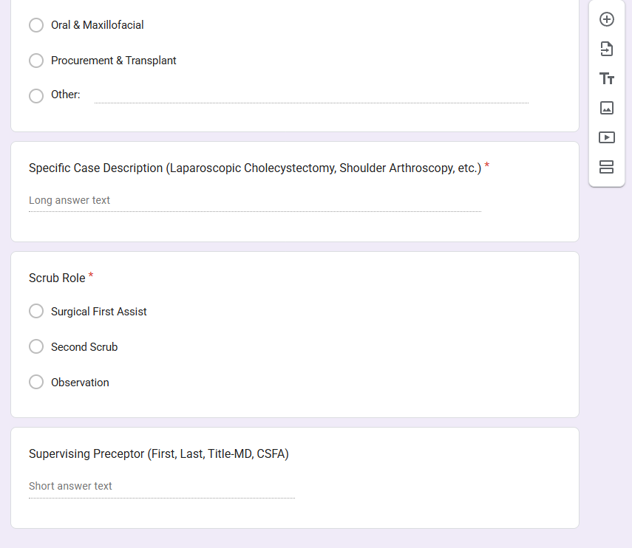
Creating an Individualized Google Form:

Slide 14
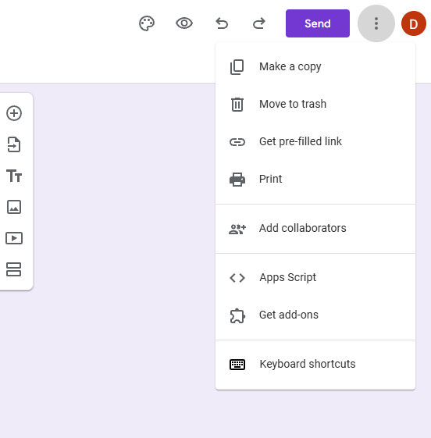
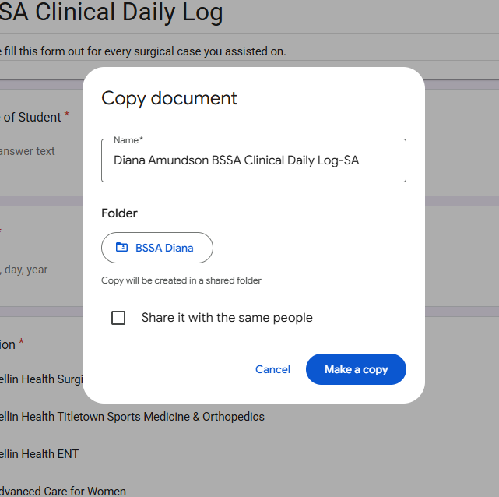
Creating an Individualized Google Form:

Slide 15
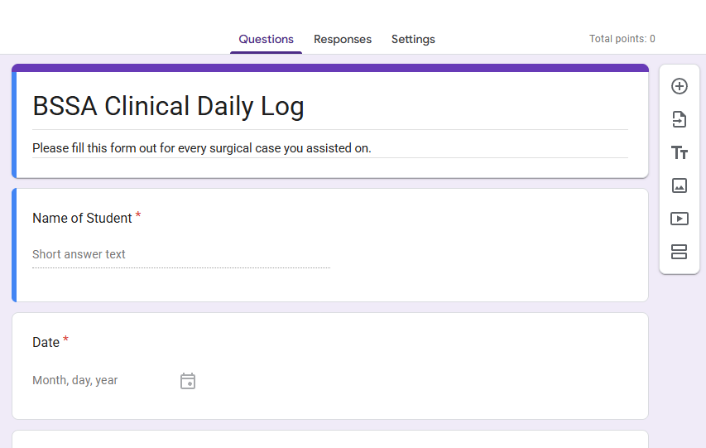
Linking Student Responses:

Slide 16
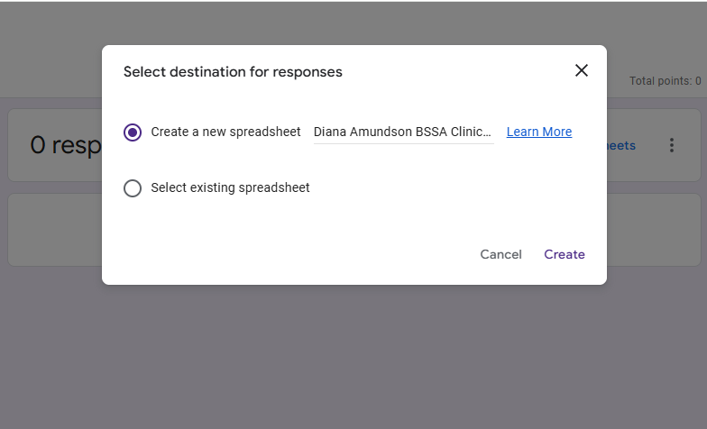
Linking Student Responses:

Slide 17
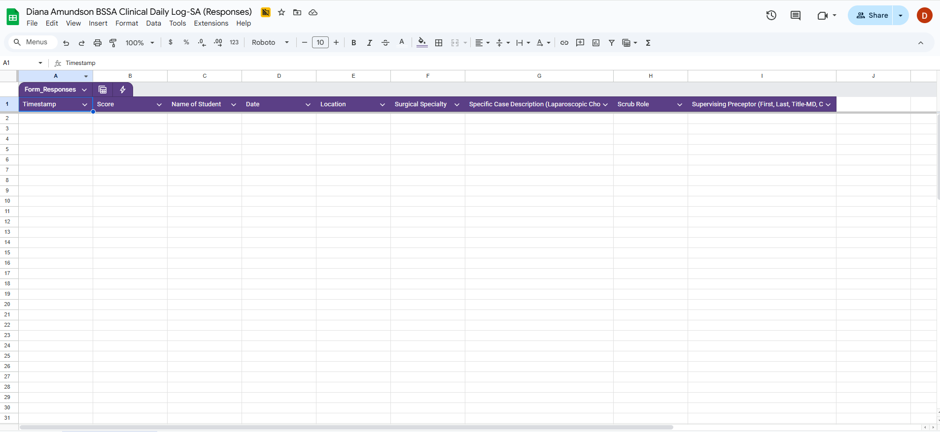
Linking Student Responses:

Slide 18
Providing Students the Link for Individualized Forms:
Personalized Spreadsheet Created
Publish Google Form with Response Link
Next Step: Email Individual Response Link to Student

Slide 19
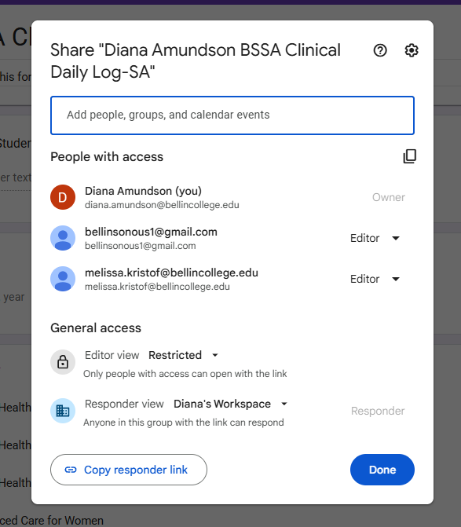
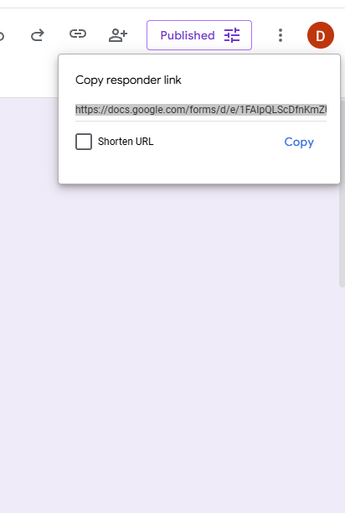
Personalized Response Link:

Slide 20
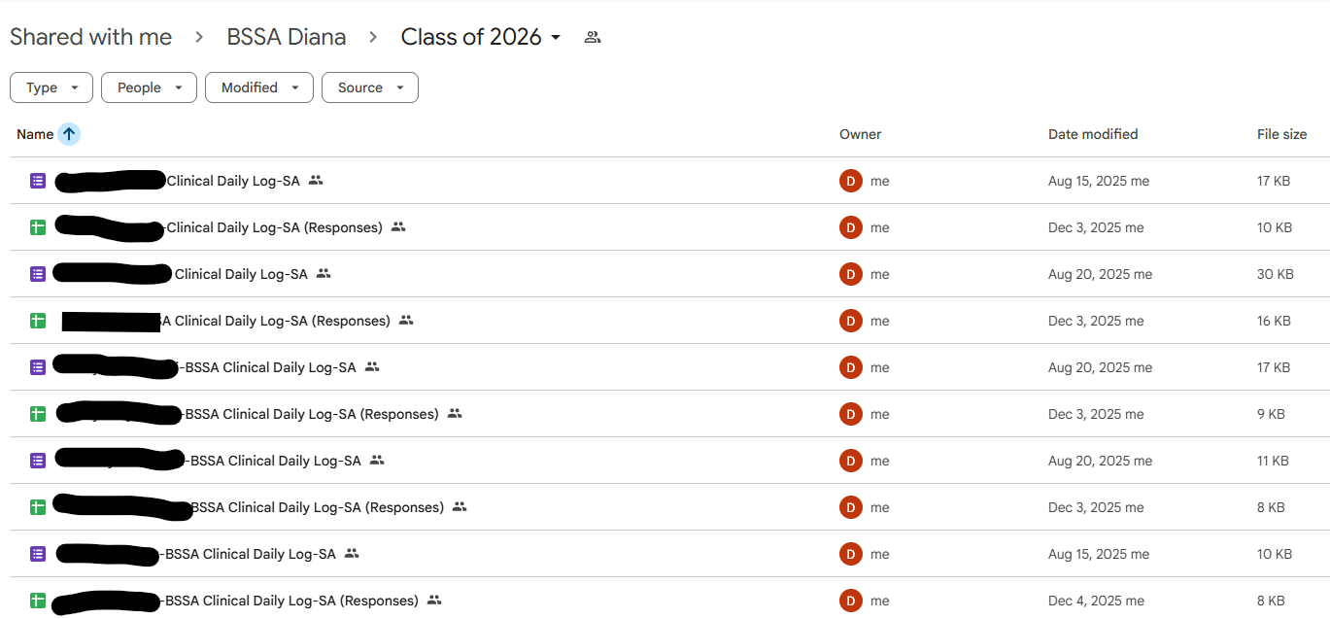
Student Information:

Slide 21
Summative Case Logs:
Perform a summative case log after each semester
Most efficient way to count cases?
Is there an easier way?

Slide 22
Initial Examples:

Slide 23
Summative Case Logs: Previous Process

Slide 24
Streamlined Process:
Utilizing the Individualized Excel Spreadsheet
Organize By Specialty-Sort List
Easily Perform Cell Count for Case Number
Identify Which Cases Were in First Assist Role

Slide 25
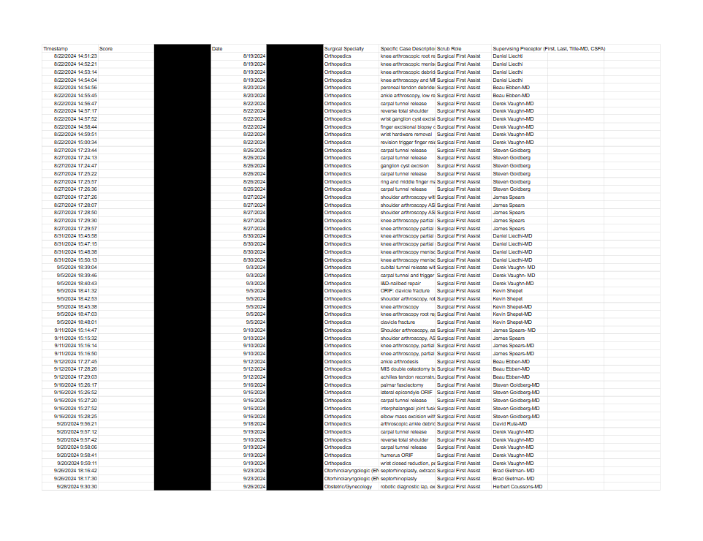
Streamlined Process:

Slide 26
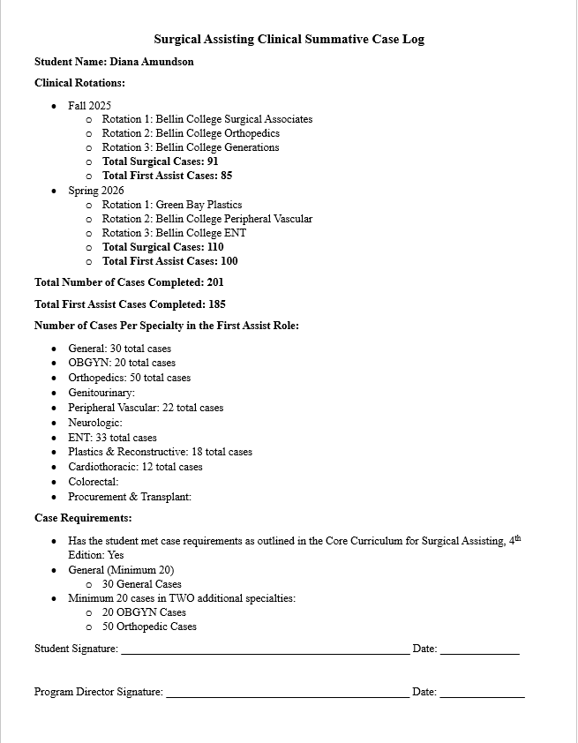
Finalized Document

Slide 27
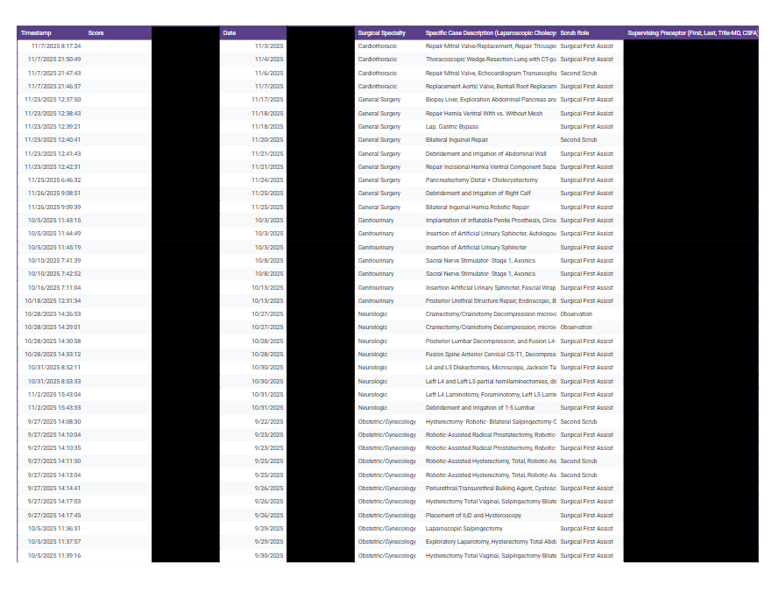
Finalized Document:

Slide 28
Required Documentation:
Sign
Students will sign their individual summative case log report
Provide
The Program Director will provide their signature, following the in-person meeting
Scan
The Program Director will scan the document into the electronic college filing system, and students will be sent a digital copy via email
Maintain
Program Director will maintain hard copies for 5 years

Slide 29
Surgical Assisting Preceptor Requirements
ARC/STSA Standards
  Clinical Preceptors
    MD or DO
  Clinical Preceptor Delegates
    CSA or CSFA
    Minimum of 3 years of experience
    Current experience must be within last 5 years

Slide 30
Preceptor Evaluation Forms
Digital Option vs. Paper Option
Frequency of Completed Evaluations
Types of Preceptors-What Will Give Us the Best Response Rate?

Slide 31
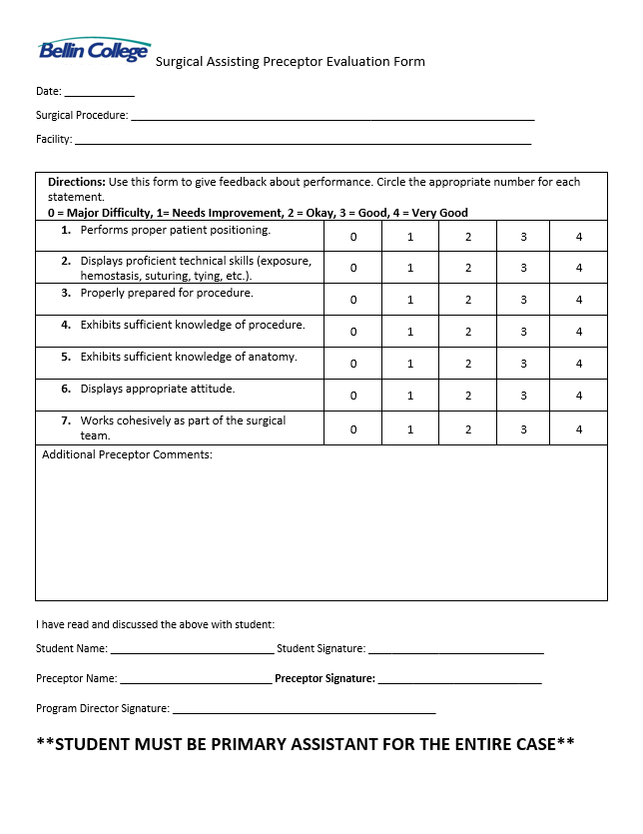
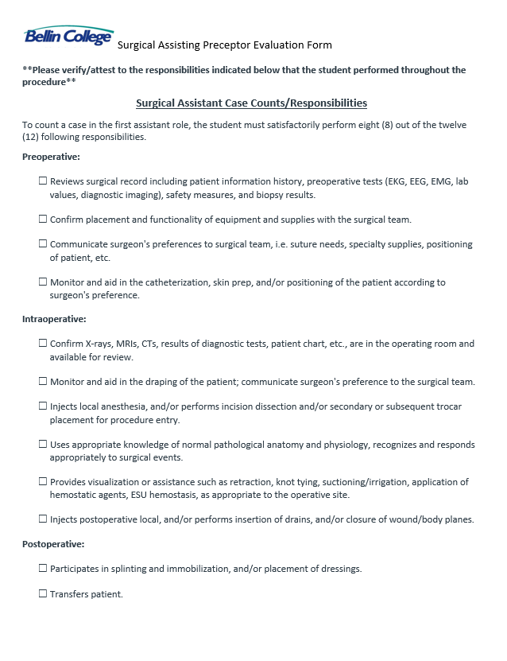
Paper Option

Slide 32
Other Documentation:
Daily/Weekly Case Logs
Compare to Google Form Responses
Preceptor Agreement Forms
Minimum One for Each Specialty Group
Faculty Evaluation Forms
In-Person Evaluations Minimum of Once/Maximum of Three Times Per Semester

Slide 33
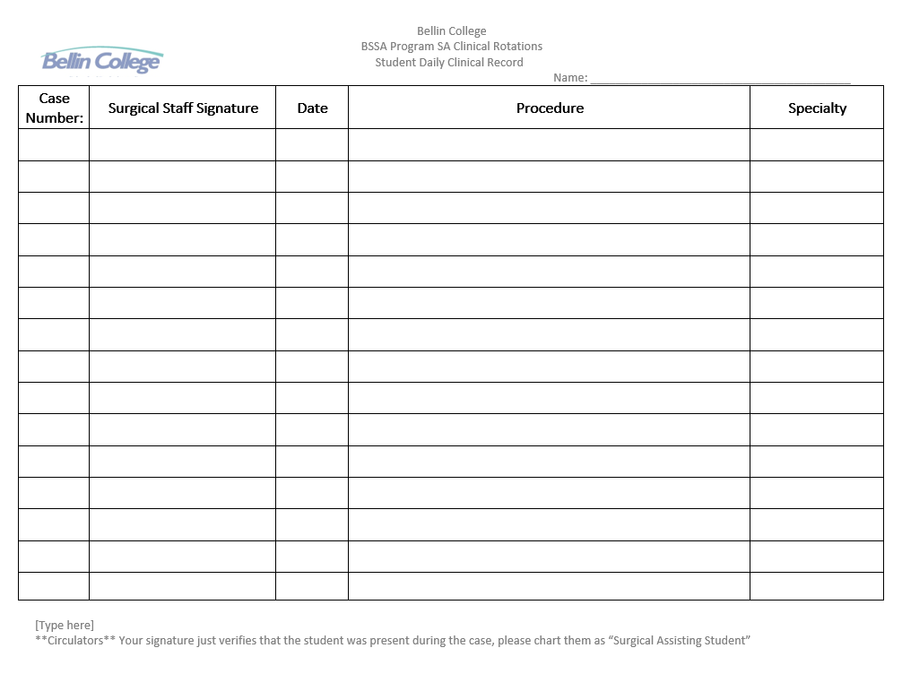
Daily Case Logs: (Current Process)

Slide 34
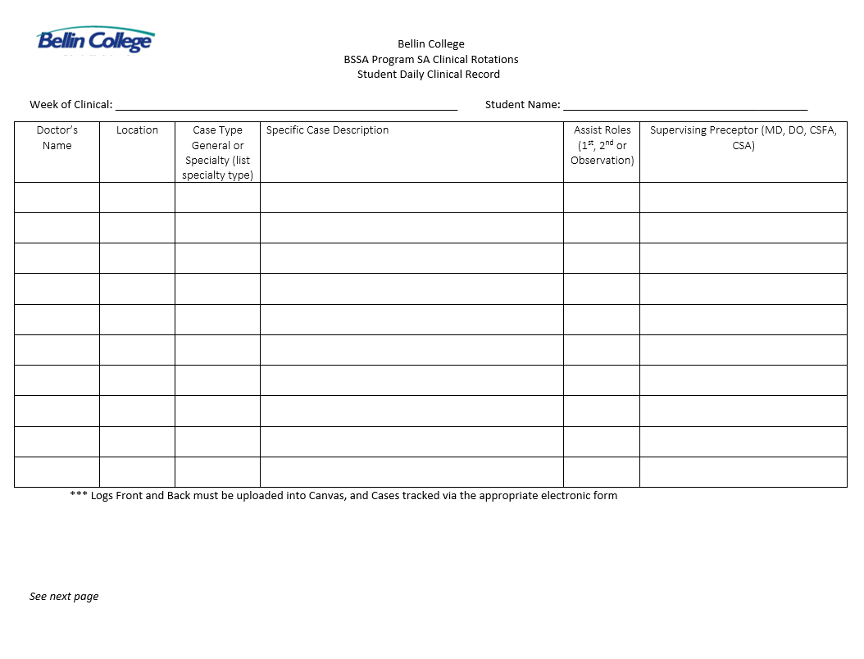
Weekly Case Logs

Slide 35
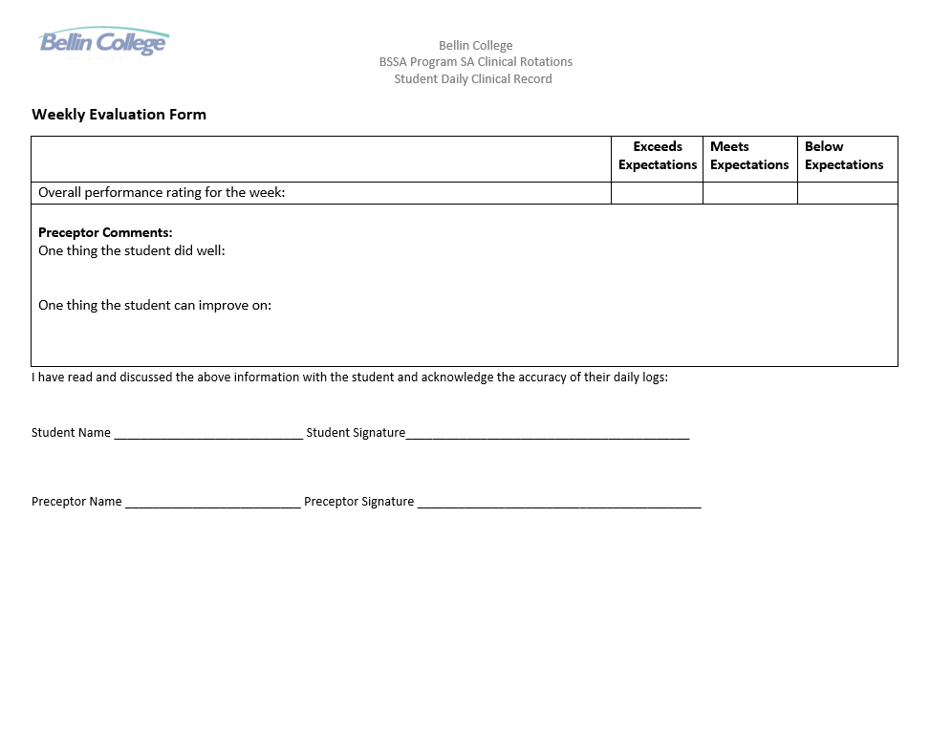
Weekly Case Logs:

Slide 36
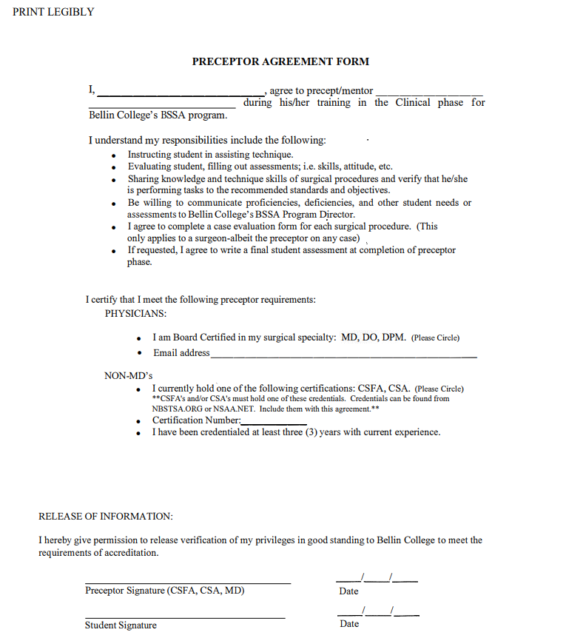
Preceptor Agreement Forms:

Slide 37
Student Responsibilities
Weekly Upload of Required Clinical Documentation
Preceptor Evaluations
Preceptor Agreement Form
Google Form with Case Log
Canvas Assignment
Strict Deadline
Will Receive 0 For Missed Deadline

Slide 38
Thank You For Your Attention!
Contact Information:
Diana Amundson, MBA, CST, CSFA
Bellin College, Green Bay, WI
diana.amundson@bellincollege.edu

